Slide 1

Dallas Area School of AI
Meetup
Oct 3, 2018

Slide 2

Introducing the deans
Nate Wood
Data Scientist at PepsiCo
Barry Barrios
Software Engineer at Raytheon
Adnan Jaffery
Sr. Project Manager at JPMorgan Chase

Slide 3
School of AI

Slide 4
Intro to School of AI
Mission to teach AI to anybody who wants to learn, for free
Youtube’s Siraj Raval - https://www.youtube.com/channel/UCWN3xxRkmTPmbKwht9FuE5A
Teach beginner through advanced concepts and techniques
Every 2 weeks – mid-week session
Weekend workshops
Online Meetings
Online Courses
Move 37 – Reinforcement Learning – www.theschool.ai

Slide 5
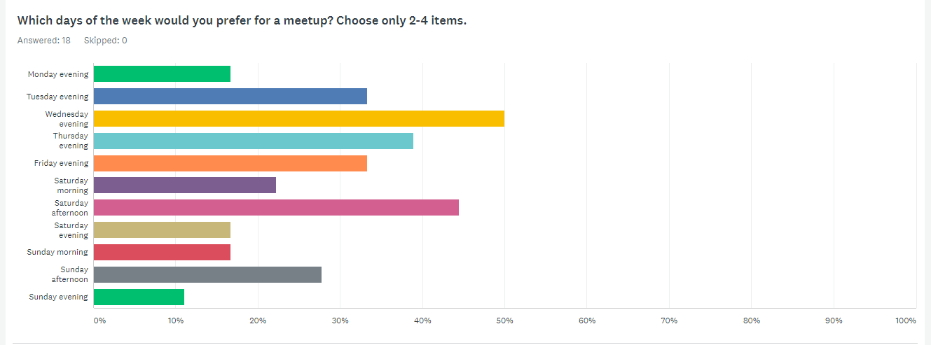
Survey Results
https://www.surveymonkey.com/stories/SM-3JTYYBY/

Slide 6
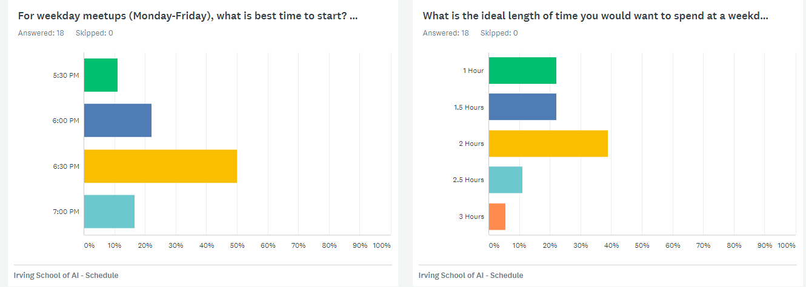
Survey Results
https://www.surveymonkey.com/stories/SM-3JTYYBY/

Slide 7
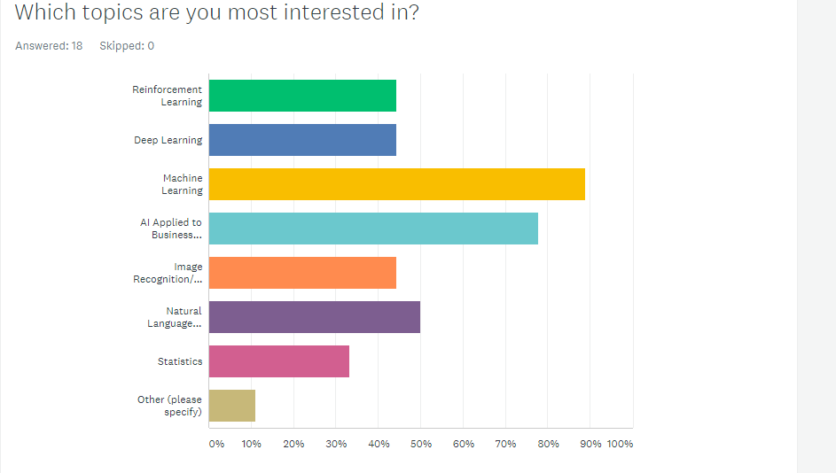
Survey Results
https://www.surveymonkey.com/stories/SM-3JTYYBY/

Slide 8
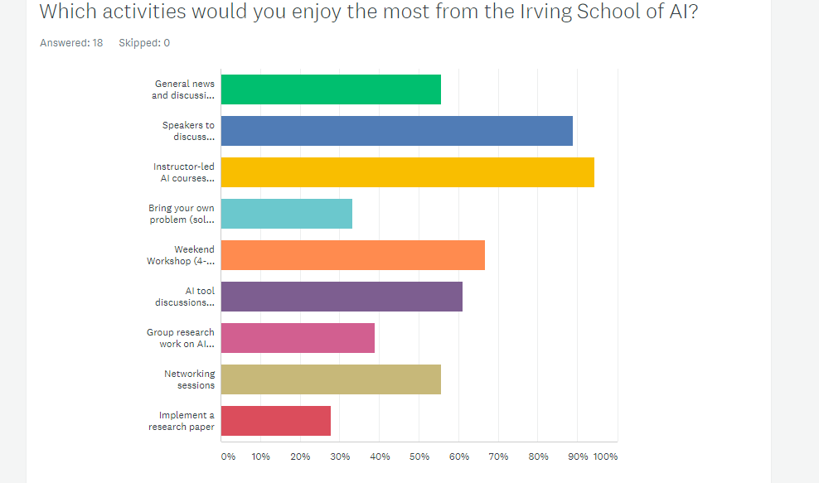
Survey Results
https://www.surveymonkey.com/stories/SM-3JTYYBY/

Slide 9
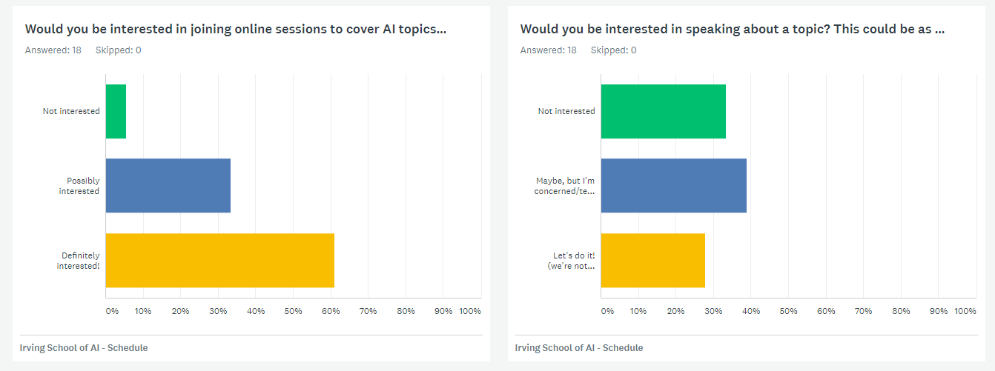
Survey Results
https://www.surveymonkey.com/stories/SM-3JTYYBY/

Slide 10
Ask the audience
How many:
Students
Data Scientists
Programmers
Analysts
Managers
Looking for a job
Hiring
Want to:
Be a data scientist
Learn basics of AI

Slide 11
Instructor-Led Curriculum
Machine Learning 101
Deep Learning
Image and Video processing
Natural Language Processing
Reinforcement Learning
Big Data

Slide 12
AI Recent news
OpenAI - Learning Dexterity
OpenAI Five

Slide 13
Today’s Agenda
AI Overview (Adnan)
Machine Learning 101
Kaggle (Barry)

Slide 14
AI Overview
Adnan Jaffery

Slide 16
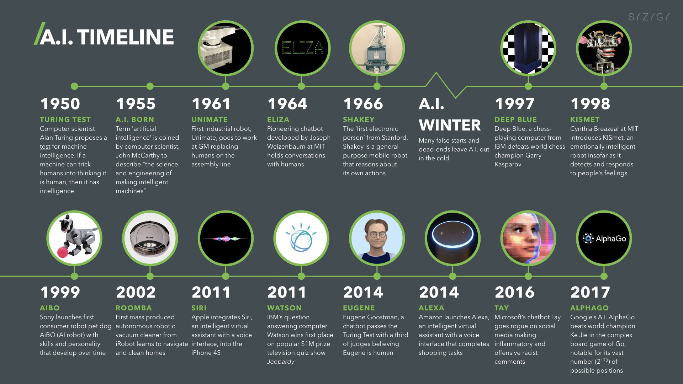

Slide 17
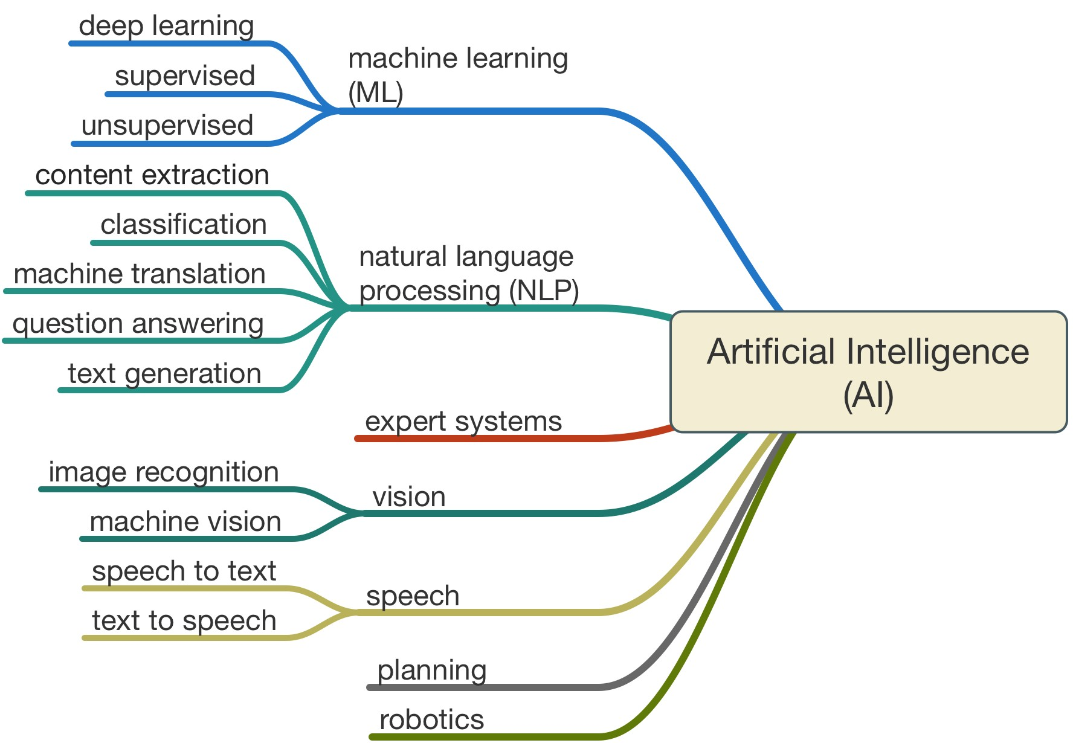

Slide 18
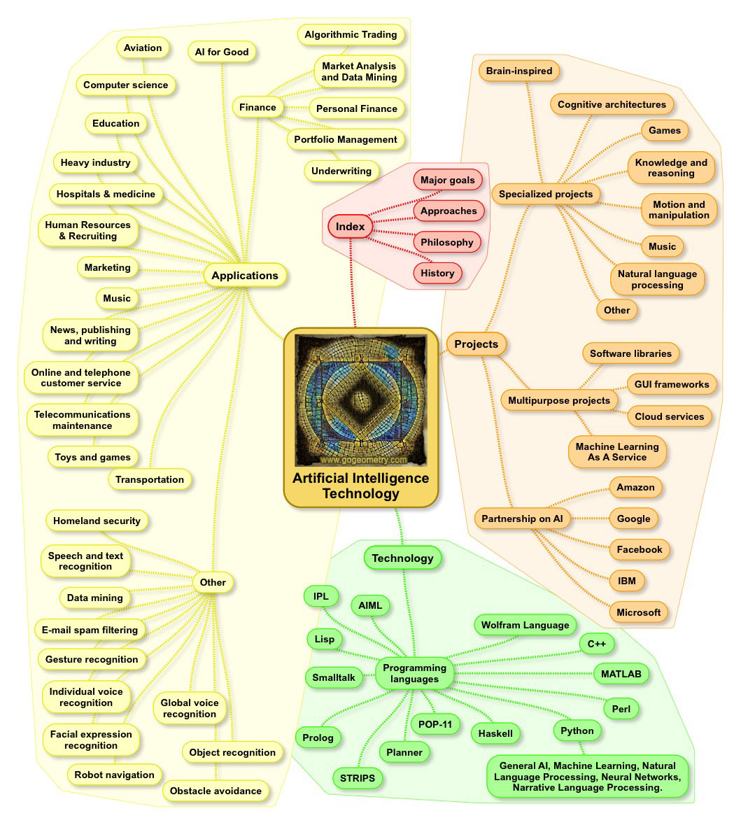

Slide 19
Machine Learning 101
Nate Wood

Slide 20
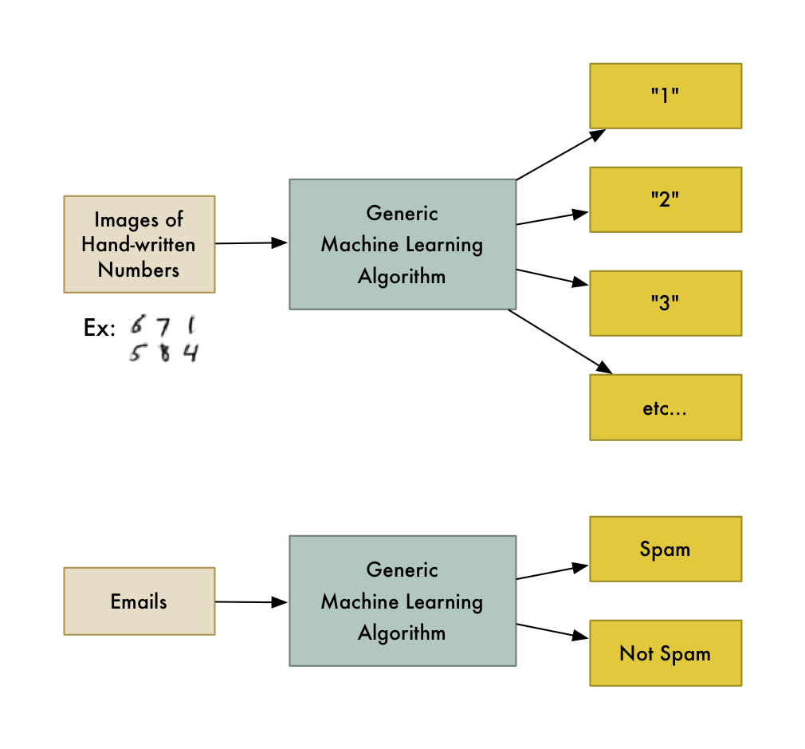
What Is Machine Learning?
Building a model to represent a system
Don’t write model details yourself – instead, provide data and let an algorithm learn the model.
Home price estimator:
Without ML: establish base price + estimate the adjustments for various factors
ML: Feed data through algorithm, build model which maximizes accuracy
https://medium.com/@ageitgey/machine-learning-is-fun-80ea3ec3c471

Slide 21
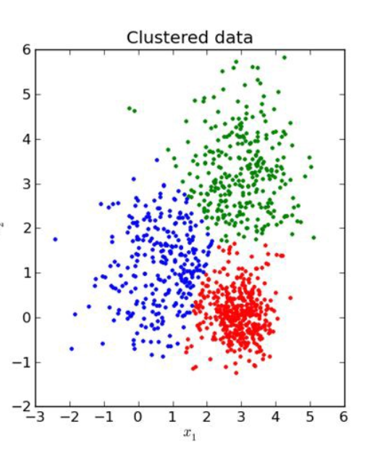
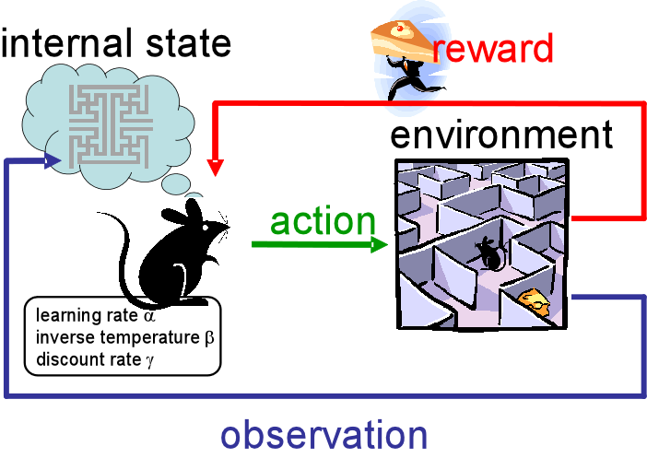
Types of Machine Learning Models
Supervised
Data has labels
Regression:
Home Price
Income
Classification
Images: Dog vs Cat
Emails: Spam vs non-spam
Unsupervised
Data does not have labels
Clustering
Customer Segmentation
Anomaly Detection
Dimensionality Reduction
Reduce number of features
Simplify the problem
Reinforcement Learning
Agent/Environment
Real Time Decisions in Environment
Self Driving Car
Game AI
Maximize reward from actions
 | Id | Sq Ft | Bedroom | Bath | Price
Train Model | 1 | 2000 | 4 | 2 | $212,000
 | 2 | 2400 | 4 | 3 | $307,000
 | 3 | 3000 | 4 | 3 | $478,000
 | 4 | 1500 | 2 | 1 | $181,000
 | 5 | 1200 | 1 | 1 | $166,000
 | 6 | 1600 | 2 | 1 | $217,000
 | 7 | 3700 | 5 | 4 | $563,000

Slide 22
Let’s Build a Model by hand!
Interactive - double click to modify. Fill in the coefficients to calculate the totals
Estimate the price of a home based on various attributes.
See the Kaggle Competition here:
https://www.kaggle.com/c/house-prices-advanced-regression-techniques

Slide 23
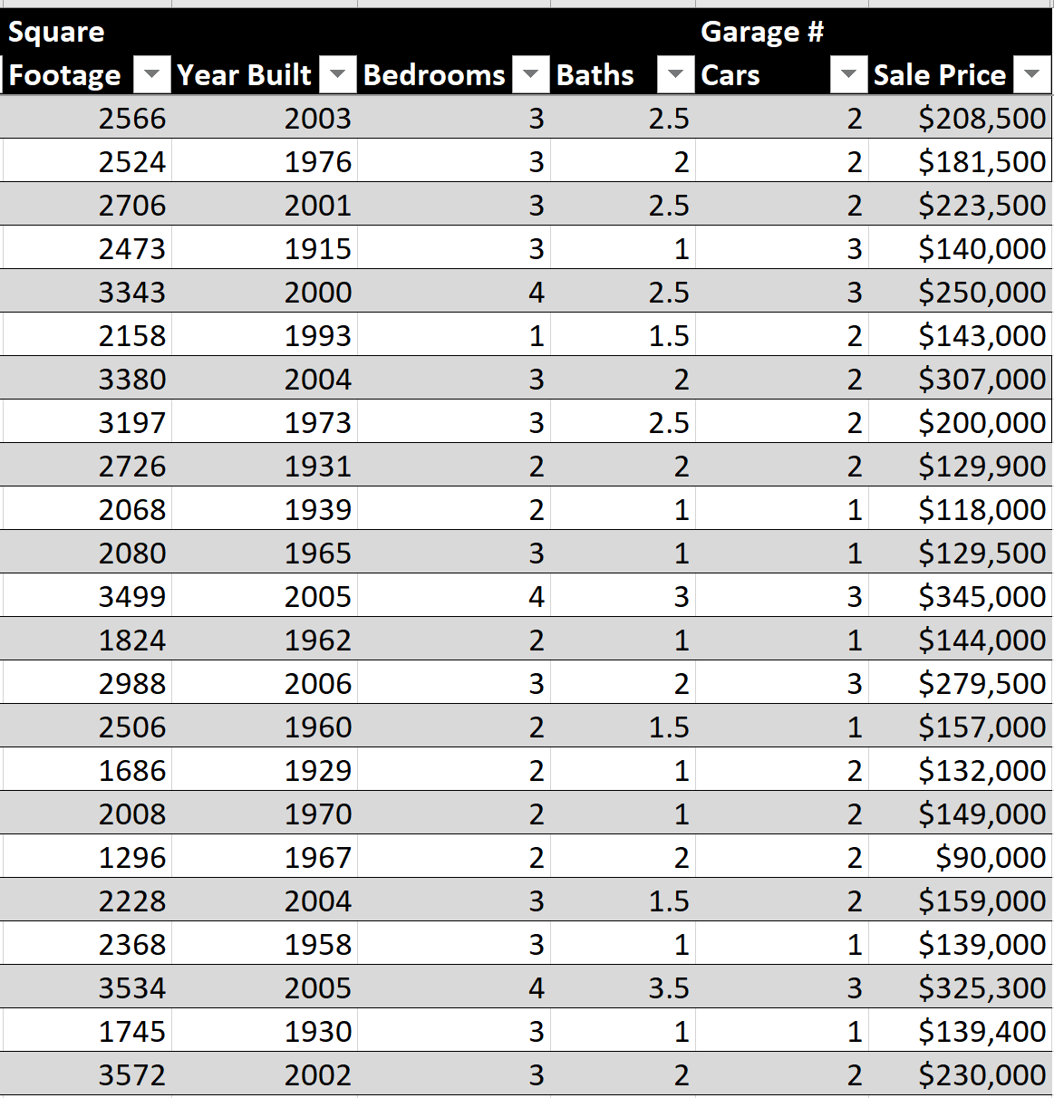
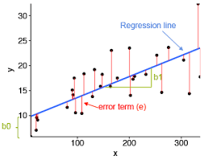
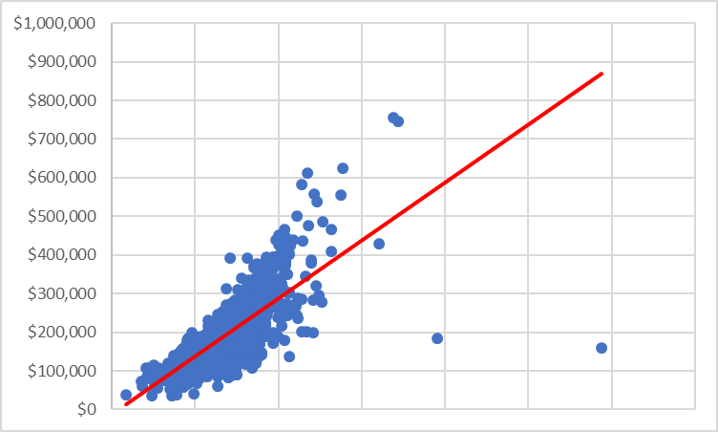
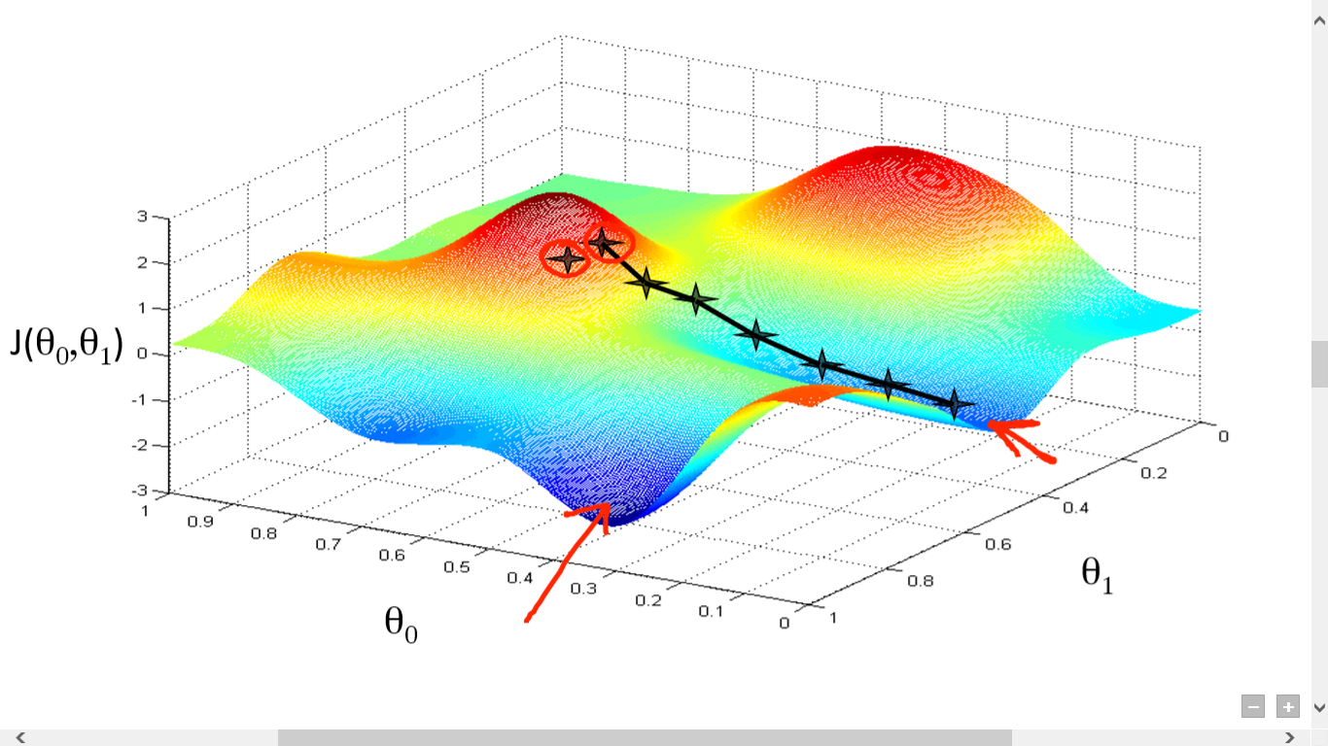
Let’s build a better model
How do we find the best coefficients? Let’s use data and algorithms to build a model.
Training Data
Train using Linear Regression
Fitted Model
Fitted model contains the coefficients which
minimizes the sum of squared residual (error)
1500 Records
Gradient Descent
This method is called multivariate linear regression
https://towardsdatascience.com/simple-and-multiple-linear-regression-in-python-c928425168f9

Slide 24
What are our new Coefficients?
Model after running linear regression on 1460 records

Slide 25
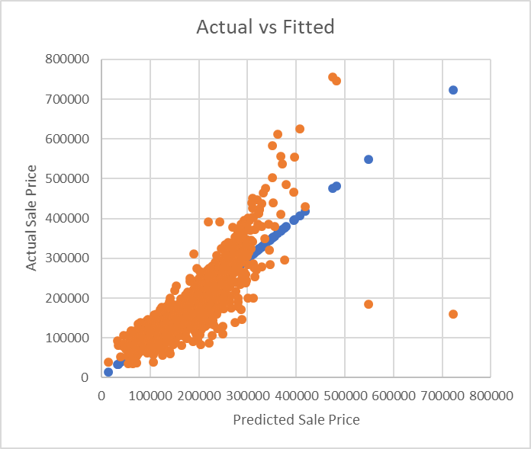

How did the model perform overall?
We’ll use a metric called R-Squared
The model’s R-squared = 0.70, which means that 70% of variations in the dependent variable (Sale Price) are explained by the independent variables present in our model.
R-squared is calculated as follows:
SSE = sum of squared error of our model
SST = sum of squared error of baseline model (baseline model is using average of actual sales as the prediction)

Slide 26
One big problem…
We calculated the performance metric on predictions from training data.
We should evaluate our model against unseen data (test data)
Common machine learning workflow:
Training Data
Train the
Model
Fitted Model
Data Source
Prepare Data
Test Data
Evaluate Model
on Test Data
Decision:
Improve Model or
Deploy Model
Deploy

Slide 27
Other Evaluation Metrics
Regression
Classification
Metrics:
R-Squared
Mean Absolute Error
Mean Squared Error
Other Eval Tools:
Actual vs Fitted plot
Residuals Plot
Q-Q Plot
Metrics:
Precision
Recall
F1 Score
Log Loss
AUC
Classification Accuracy (Easily Misused)
Other Eval Tools:
Confusion Matrix
ROC Curves
https://machinelearningmastery.com/metrics-evaluate-machine-learning-algorithms-python/
http://scikit-learn.org/stable/modules/classes.html#module-sklearn.metrics

Slide 28
Other Algorithms
Regression
Classification
Clustering
Linear Regression
Decision Tree Regression
Random Forest Regression
XGBoost
Support Vector Regression
Generalized Linear Models
Neural Networks
Logistic Regression
Decision Tree Classifier
Random Forest Classifier
XGBoost Classifier
Support Vector Classifier
Neural Networks
K-Means
Mean-Shift
PCA
Feature Selection Methods
Dimensionality Reduction
http://scikit-learn.org/stable/index.html

Slide 29
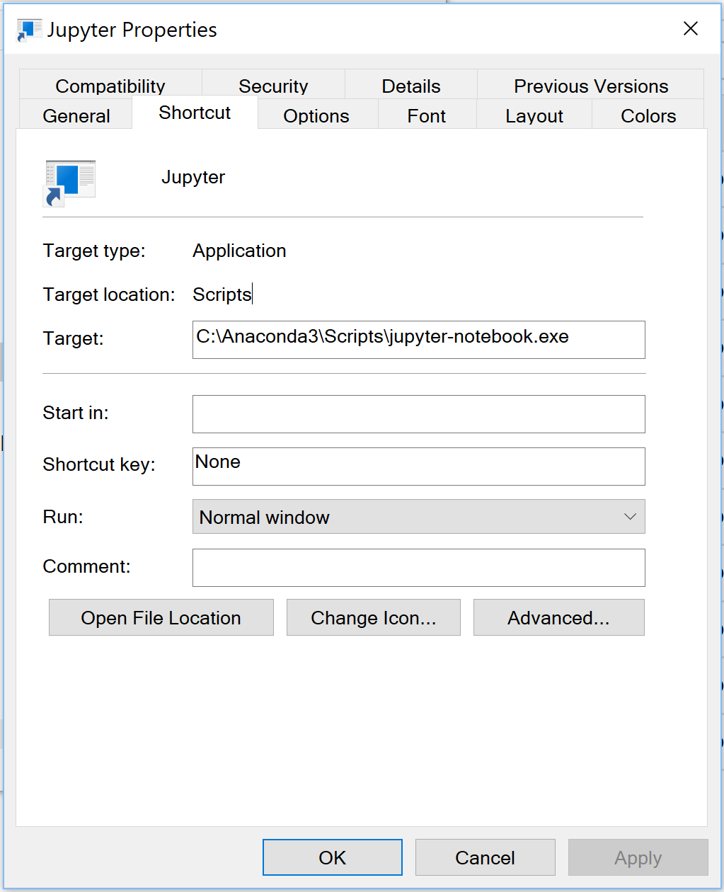
Let’s see some code!
Install: https://www.anaconda.com/download/
Choose Python 3.7 version
After installation, create jupyter notebook shortcut in your project folder →
Run the shortcut, it will open a command prompt and it will open a webpage
Use the web interface to begin.

Slide 30
How could we improve this model?
Add more features! Year Built, Year Sold, Has pool, Condition, Interior Quality, Ext Quality,, Neighborhood Geography, Comparable Home Sales ……………
Add more data – we only had 1500 records to train our model
Normalize data - House prices do not have a linear relationship with all features. When using linear regression, we need to normalize the data to get closer to linear relationships
Try other algorithms - Random Forest Regression, XGBoost, Neural Networks

Slide 31
Conclusion

Slide 32
Next Meeting
October 17
Format options:
2 hours of speaking/teaching, similar to today.
1 hour of speaking/teaching, followed by 1 hour of hands-on
Ask the audience:
Intro content? Advanced content?
Industry speakers
Online meetup?
Who has a topic they’d like to speak on? Send me an email: nwoodro@gmail.com

Slide 33
Dallas Area School of AI
Thanks for Coming!

